Slide 1
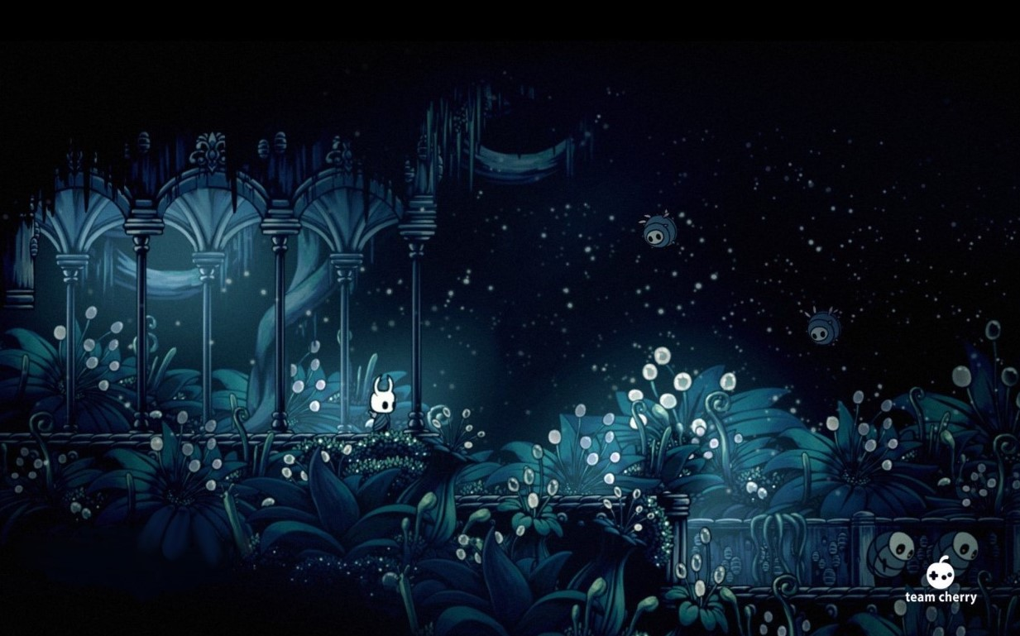
Hollow Knight – Analysis
Notes:
This is an analysis of the narrative of Hollow Knight.
We chose to discuss the following topics: Person VS Themselves, Group VS Group, Non-Linear Story Structure, and Person VS Environment.

Slide 2

Characters We Discuss
The Knight - This is the Player Character. A combination of the Void and a body, created by the Pale King and White Lady.
The Void - The Void is a complicated character that is both a sentient and not sentient. It is more of an essence, that is given physical form. The Pale King attempted to use the Void to create the Siblings. Examples of the Siblings are the Knight and the Hollow Knight.
The Pale King - A god-like being that is essentially the Father of the Siblings. Used the Void to create the Siblings in an attempt to contain The Radiance.
The Radiance - A moth god that created the Infection to gain revenge on the Pale King for taking her subjects.
The Hollow Knight - The Sibling that was chosen to hold the Infection(Radiance). It was not truly hollow, allowing the Infection to leak out, creating the events of the game.
Hornet - A Half-Sibling, challenging and possibly helping the Knight in their quest. Is not made of Void.
Notes:
Firstly, we will introduce some characters we will discuss.
The Knight is the player, made of Void and created by the Pale King and White Lady. One of many attempts to create the Hollow Knight.
The Void is complicated. The Void is a substance that is repeatedly described as being empty, not having a will. Despite this, it moves and acts as though it has a will. The Pale King tried to use The Void to create the Hollow Knight in order to contain the Infection.
The Pale King is a godlike being that fathered the Siblings. He thought a creation born of God and Void could hold the Infection/Radiance and save his Kingdom.
The Radiance is a moth god that was the former ruler of the world of the game, who was forgotten by her subjects once the Pale King took over. The Infection is her way of forcing the bugs to follow her once more.
The Hollow Knight was the Sibling that was supposed to hold the Infection. It was supposed to have “No mind to think. No will to break.”, as said by the Pale King. However, after being raised by the King, it’s possible the Hollow Knight was not truly hollow due to it’s parental bond, and allowed the Infection to leak out, creating the events that start the game.
Hornet is a child of the Pale King and another character, who challenges and (depending on the ending) helps the Knight in their quest. However, she is not made of Void.

Slide 3
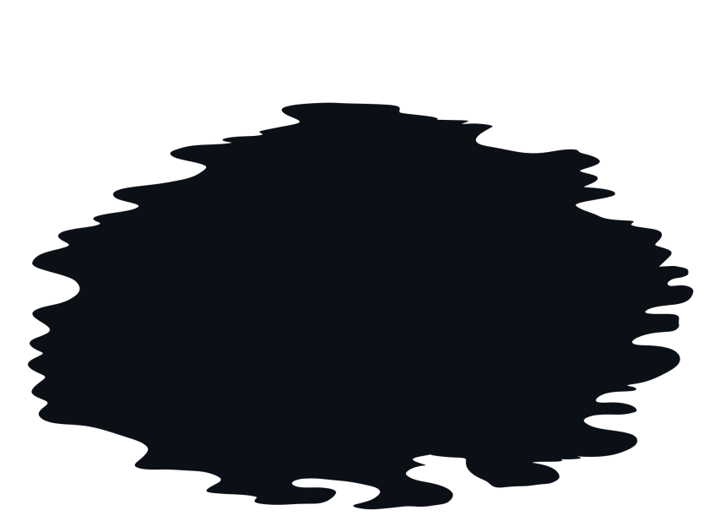
Person VS Themselves
Person VS Themselves shows a character’s conflict within themselves.
Like most of Hollow Knight’s story most of this section is “hidden” and not “required” for completion of the game
Of Hollow Knight’s 5 endings, the events I will be talking about are required for 4 of them.
Notes:
Person VS Themselves.
This shows a character’s internal conflict, a fight shown through their actions in the game.
Of Hollow Knight’s 5 endings, this particular section of the story is required for 4 of them, but not required for the completion of the game.

Slide 4
Person VS Themselves
In order to gain access to the remaining 4 endings, the Knight must gain the Voidheart charm.
Voidheart description says “An emptiness that was hidden within, now unconstrained. Unifies the void under the bearer’s will.”
This makes the Knight become the Lord of Shades.
Notes:
The Knight must gain the Voidheart charm in order to become the Lord of Shades. The Voidheart description says “An emptiness that was hidden within, now unconstrained. Unifies the void under the bearer’s will.” This raises many concerns as to if the Knight has a will to “control” the Void, then is the Knight truly hollow, or will the Siblings ever be able to truly hold the Infection? 3 Endings involve the Radiance being killed, which does end the Infection, but at the cost of (possibly) letting the Void out to do as it pleases in the world.

Slide 5

Person VS Themselves
The Charm indicates that despite being made of Void, the Knight does have a will.
Before gaining the Voidheart, the Knight was unaccepting of a part of itself, which kept it separate from the Void and it’s Siblings.
After gaining the Charm, the Void, Shades and Siblings become passive towards the Knight, showing it is now recognised as a part of the Void.
Notes:
The game shows the struggle the Knight has with itself through the creatures born of the Void being hostile to the Knight until it gains the Voidheart Charm. Once the Knight has accepted the Void within itself, they become passive and allow the Knight to direct where the Void should go and do, as shown at the end of the fight with the Radiance, where the Knight and Void become one to create a monstrous form to defeat the Radiance.

Slide 6
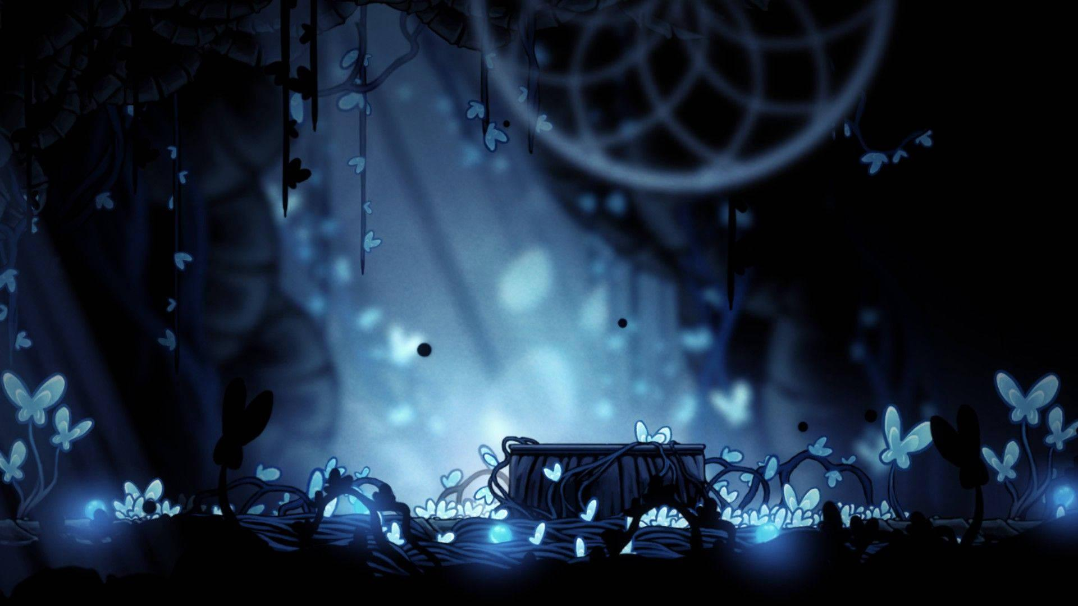
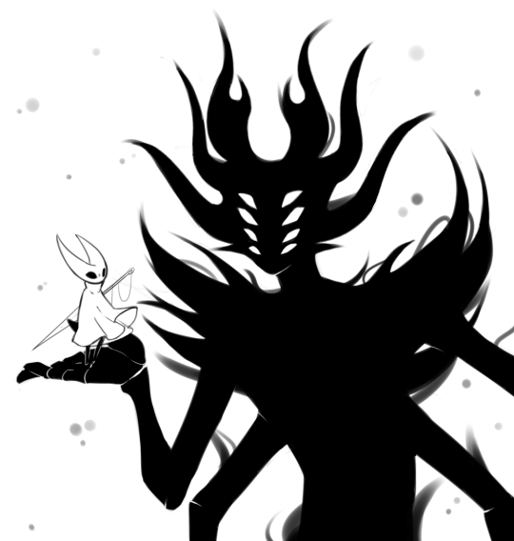
Group versus Group Conflict: The Void
Group vs. Group conflict is prevalent as Void vs. Radiance
An unusual case of Good vs. Evil
Void exists in two states, a liquid and as a substance given form.
It has a visible effect on living beings and objects throughout the Ancient Basin.
Notes:
The group versus group conflict in Hollow Knight is prevalent as the conflict in this game is between the Void and the Radiance. Void inherently opposes light and is often referred to as darkness and shadow. It exists primarily in two states, as a liquid and as a substance given form. It has an effect on living beings and on objects. It appears to kill various creatures throughout the Ancient Basin such as the bug that holds the Love Key, who has void leaking from their eyes. The largest amount of liquid Void is the sea of Void at the bottom of the Abyss. When the Void is not unified and when light does not shine upon the liquid in the Abyss, it lashes out with sharp tendrils towards intruders. If the Void is unified or light is shone upon the liquid, it remains perfectly still.

Slide 7
Group versus Group Conflict
The Pale King discovered the Void shortly after arriving in Hallownest
He took some of the Void to a workshop and began creating constructs containing it.
The Pale King turned to the Void to try fight the Radiance once the Infection first appeared in the kingdom.
The Pale King had many children that contain the Void and would be helpful in fighting this infection.
Notes:
Sometime after the Pale King arrived in Hallownest, he discovered the Void in the Abyss. He built a lighthouse on top of a natural spire near the sea of Void which was used to suppress the Void. The Pale King took Void from the sea and used it in his workshop in the White Palace to create constructs that have Void within them. And as we all know, the cliché of taking unknown substances and making inventions, weapons, or creatures from it never ends well.
When the Infection first appeared in the kingdom, the Pale King turned to the Void to seal away the Radiance, who was the source of the Infection. He and the White Lady had countless children together who were born in the Abyss, which turned them into beings who have Void inside their natural shell.

Slide 8
Group versus Group Conflict
Pale King chose the Hollow Knight, as the vessel for the infection that would doom everyone.
It became clear that the Hollow Knight would not be able to contain this Radiance forever, therefore the Knight must defeat them.
Our Hero must use the Void within himself to defeat the Radiance.
Notes:
The Pale King chose one of these children, the Hollow Knight, to be the Vessel that would seal the Radiance inside themself. At an unknown point after being sealed inside the Temple of the Black Egg, it became clear that the Hollow Knight could not contain the Radiance forever, leading to the ruin of the kingdom. This is where our protagonist, the Knight, comes in.

Slide 9
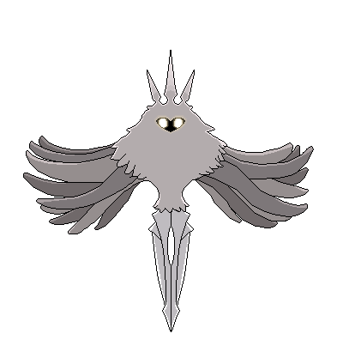
Group versus Group Conflict: The Radiance
The Radiance was a powerful Deity and creator of the kingdom of Hallownest.
The Pale King usurped her and freed the kingdom of the power that is her hive mind.
Notes:
The Radiance was a powerful deity, and creator of the kingdom that is Hallownest, until the Pale King arrived, usurped her and freed the kingdom of her hive mind control. While, a complicated storyline, when stripped down to the bare necessities, we can identify the conflict that the story of Hollow Knight is based upon.

Slide 10
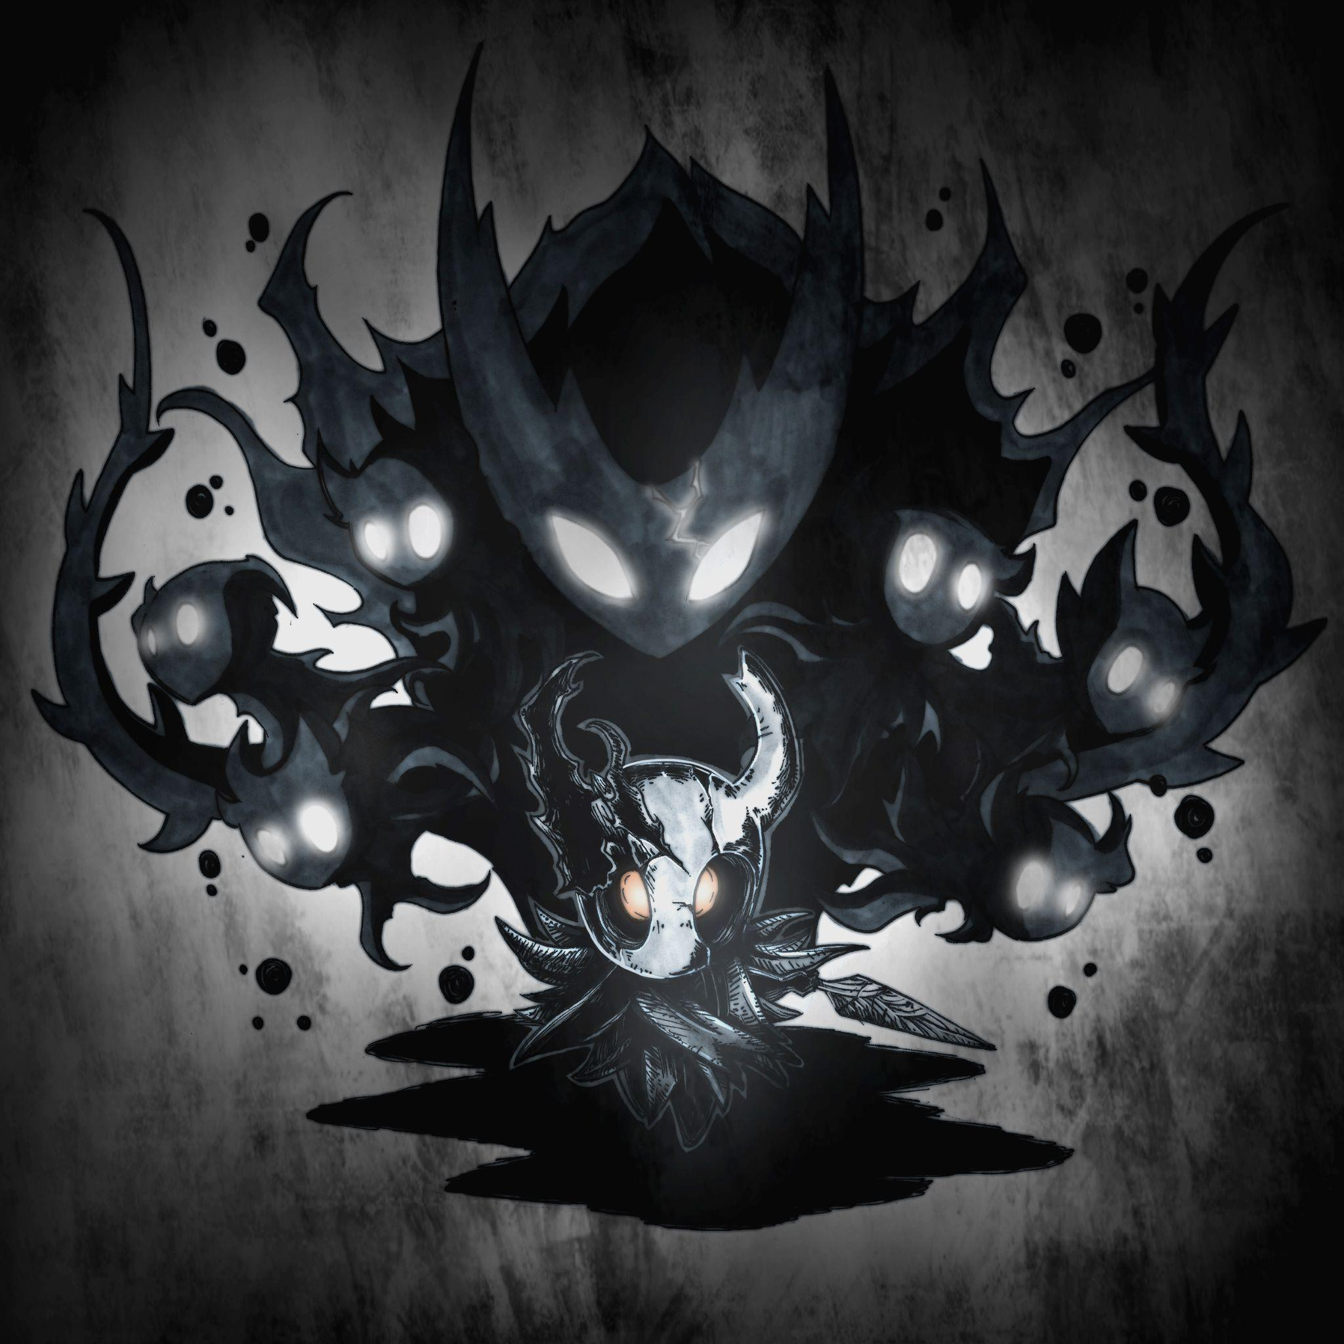
Group versus Group Conflict: Is it Clear?
Ambiguous definition of Good vs. Evil
Void is the enemy of Light, and the different sources of Light do not share power with each other.
I don’t believe either are good or evil.
Void is portrayed as a force of chaos, power and disunity.
Light is portrayed as a force of order, control and unity.
Not exactly good vs. evil but there definitely is a clear divide.
Notes:
The group versus group conflict is a not so classic case of Good versus Evil. While the variation of creatures stands in the Hero’s way, we struggle to clearly see how the divide is there. Our Hero must use the Void within him to defeat the supposed Evil that is the Radiance. It is what The Pale King chose him to do, as his child and the vessel to hold the Void. However, the portrayal of both sides is never clear, more ambiguous than anything. The Void is the enemy of light, while Light is the enemy of the Void, and the different sources of Light do not share power with each other. I don’t believe either are good or evil. Meanwhile, Void seems to be portrayed as a force of chaos, power, and disunity, and Light as a force of order, control, and unity which isn’t exactly good versus evil but it’s something.

Slide 11

Non-linear story Structure
Hollow Knight uses a Non-Linear story structure
It incentives player exploration within the game
Allows the player to define the order of events
Brings interesting character interactions into the world
Increases games replayability
Notes:
Hollow Knights Story follows a non-linear narrative structure. This means that the events of the game don’t happen in any particular order that the player must follow instead the player can freely explore their options and go from one event to another in any order they like. If executed well a non-linear game can incentives the player to explore the world, make the players decisions in the world to be meaningful through the way they affect other events, bring interesting character interactions into the world and improve the games replay ability.

Slide 12

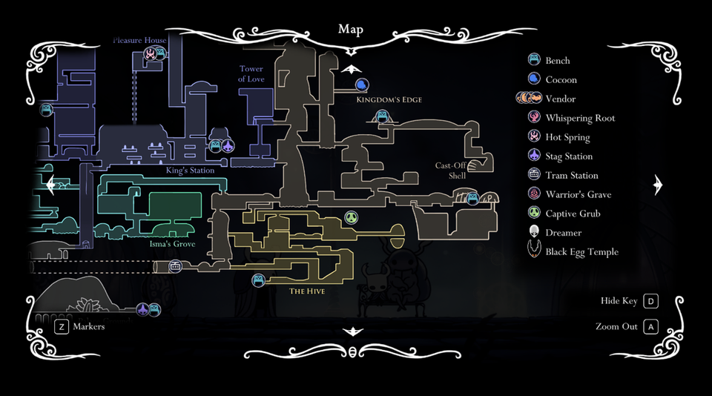
Player Exploration
Hollow Knights Non-Linearity uses Player Exploration for progression
The world is filled with different power-ups and interactable objects
The player can find different characters and stone tablets on their travels
Most of which are optional, incentivising the player to explore if they want to learn more about the world.
Fig 1: View of the map in Hollow Knight
Notes:
One of Hollow Knights biggest features is its vast world, the game uses this world very effectively by making the player feel lost during their adventure and it’s a key part of the game’s progression and feel. The world is filled with different areas, items and secrets for the player to explore and find. As well as that the player can also meet a large variety of enemies, bosses and NPCs that they can interact with. Most of these explorable parts of the game are optional which makes finding them extremely rewarding for the player

Slide 13
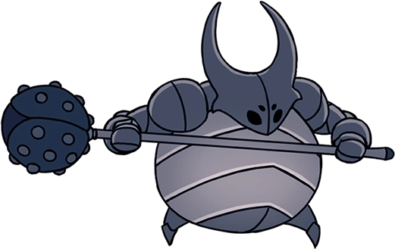
Order of Events
Hollow Knights game progression is shown through bosses and areas
The game contains 47 bosses and 15 areas
Only 4 bosses are unavoidable in the game
The bosses the player defeats influence the world, player abilities and possible endings
Fig 2: False Knight boss from game
Notes:
Hollow Knights progression can be seen through the areas and bosses the player meets, As the player defeats different bosses and unlocks abilities more and more of the world is accessible to the player. The players dedication to defeat these bosses is rewarded via unlockable and currency the player can use to buy more items from different characters in the game. As well as the satisfaction of overcoming a difficult fight. The fact that only 4 bosses in the game are required to beat it with the other 43 being completely optional creates opportunities for the players to build a community around the narrative of the game, sharing their experiences and knowledge with others trying to piece together the story of Hallownest the location the game takes place in.

Slide 14

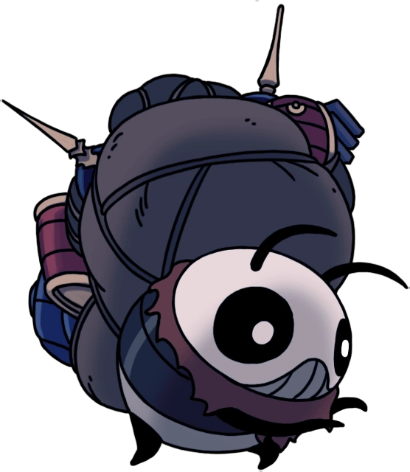
Characters
Hollow Knight has a good cast of characters
These characters have their own roles in the world such as:
Storytelling
Selling / Giving items
Assisting the player
Characters bring life to the world
Fig 3: Tuk a npc vendor from Hollow Knight
Notes:
Hollow Knight effectively creates interesting characters, each character the player finds has their own purpose in the story, whether it is assisting the player in their battles, teaching them new abilities, selling items or just sharing their story. Characters vary from the villagers of the town on the surface to explorers trying to uncover the secrets of Hollownest. This effectively brings life to the world showing the player that there is more to the world than what meets the eye, this is particularly visible through the character called Hornet and some of the other explorer characters. Who the player can meet in different locations throughout the world, suggesting that they are progressing in their adventure just as much as the player.

Slide 15
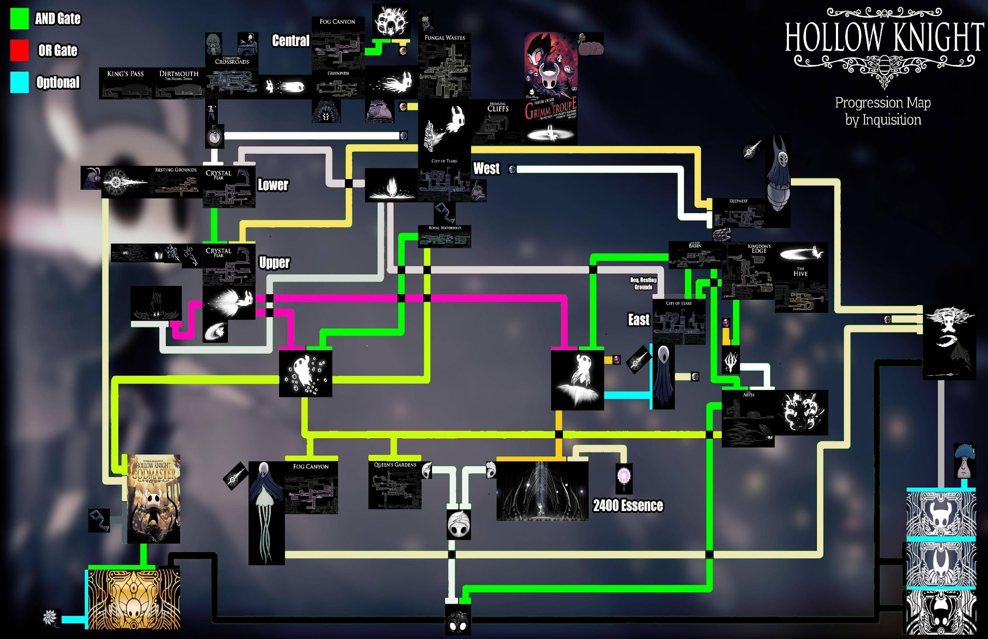
Replayability
Hollow Knight has 5 different endings
Each ending has its own requirements
The large amount of optional pathways can motivate the player to revisit the game
Fig 4: Progression Map of Hollow Knight
Notes:
Hollow Knight uses its non-linear story to make the game replayable through different endings, players who completed the game may want to return to the game just to try and experience other ends, players who are invested in the narrative of the game may come back to the game to try and uncover more of its secrets and players who seek challenge may be interested in beating all of the bosses they have missed in their previous runs.
Overall Hollow Knight masterfully perfects its narrative style, although the narrative is not given to the player directly the sense of being lost in the world with no hints to what is happening creates a drive in the player to learn what they are facing all of the challenges ahead of them for. Although the world is vast its strong characters, interesting areas and bosses bring life to it, in a way that the player just can’t get enough of.

Slide 16
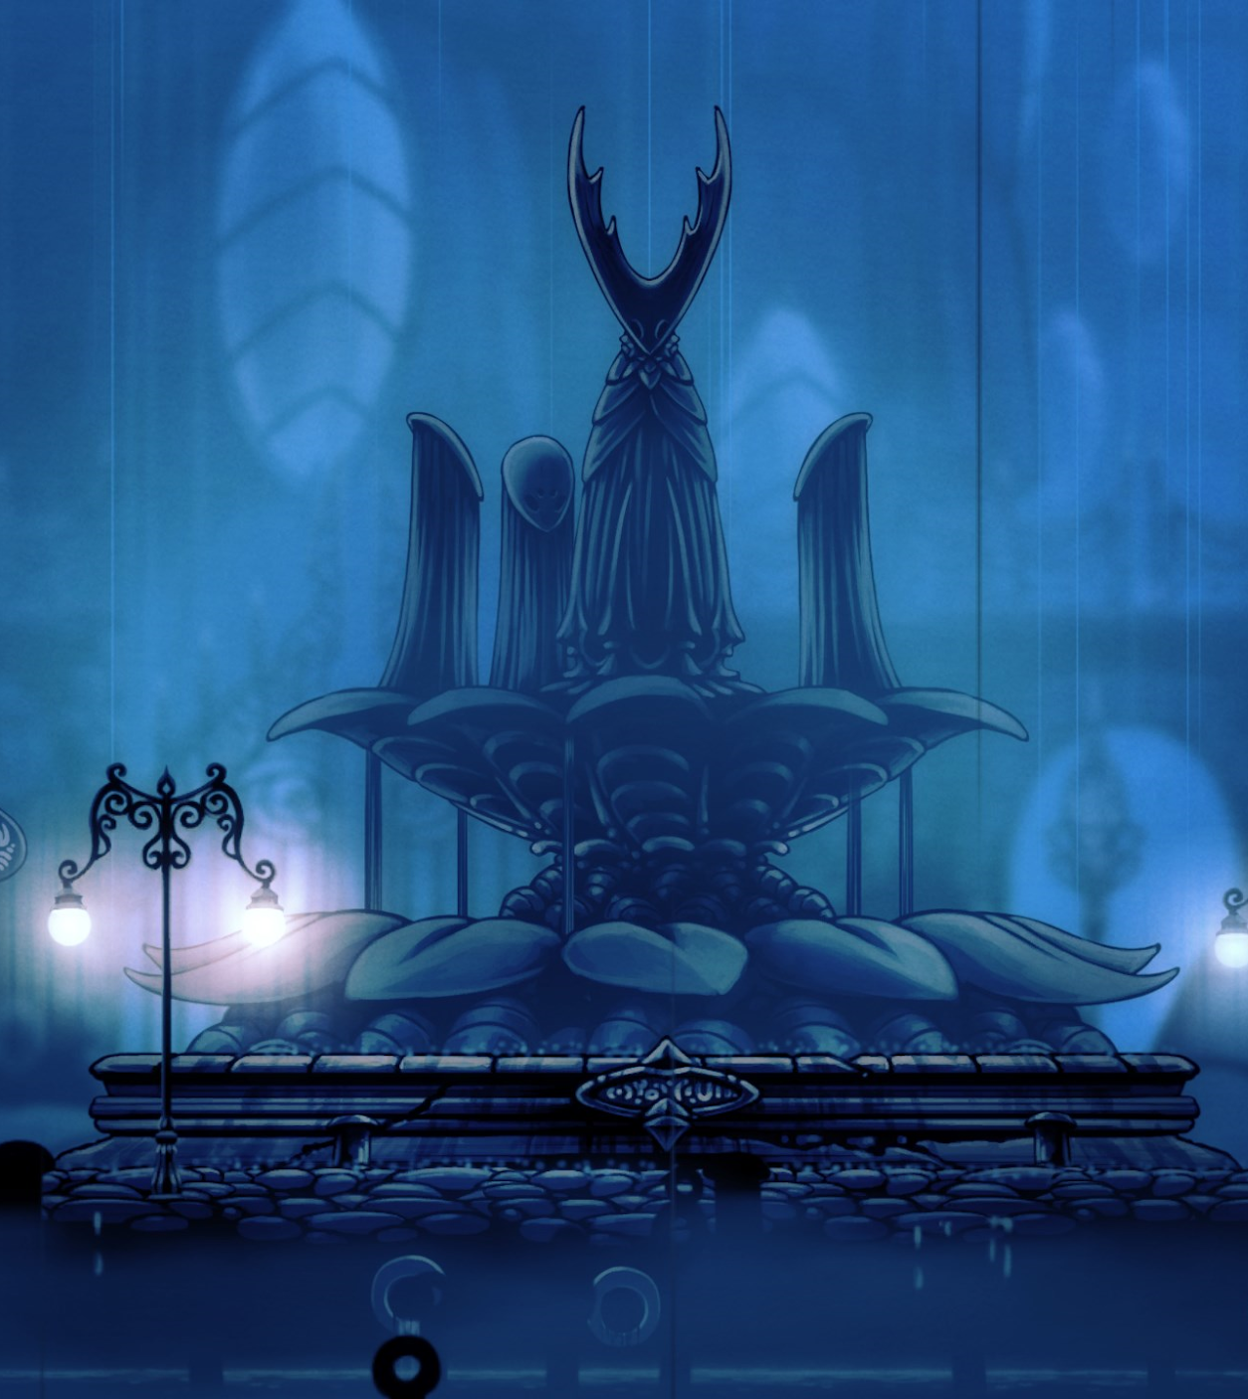

Environment
The game takes place almost
entirely in the grand, underground
city of Hallownest.
The game uses vivid, moody detail, its caverns alive with bizarre and terrifying creatures
The areas are unified with their use of colours, recurring enemies and environmental detail, making a clear distinction in the players progress
Notes:
The actual script:
The Game takes place almost entirely in the underground city of the Hollownest. The Game puts a lot of emphasis on world building and creating a strong sense of immersion for the player, which helps greatly with the games ability to convey a good and convincing story.
The game uses a lot of thematic colour schemes, vivid and moody details in the environment and most notable is a lot of background details which gives the player the impression that this world exists outside of the players interactions with it. You can sense the ancient history of the land from its ruined structures, giant barred doors and intricate architecture. Everything in Hollow Night feels like it was put into the game for a reason, like there is story behind every detail.
Notes:
The game takes place almost entirely in the grand, underground city of Hallownest, where an ancient being called the Pale King has given sentience to his insectoid subjects so they can worship him as a god.
The world of Hollow Knight is brought to life in vivid, moody detail, its caverns alive with bizarre and terrifying creatures, each animated by hand in a traditional 2D style. Every new area you'll discover is beautifully unique and strange, teeming with new creatures and characters to discover

Slide 17
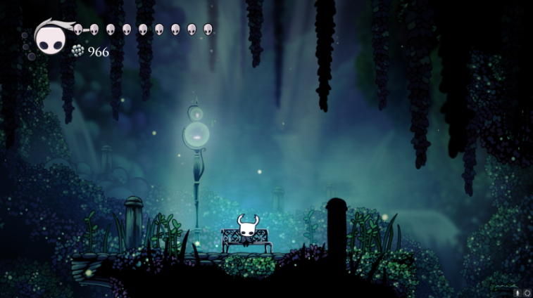
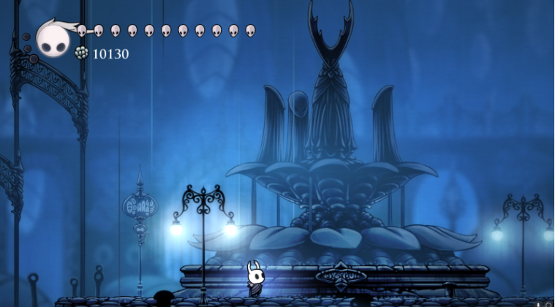
Colour & Lighting
Heavy contrast: puts emphasis on areas of interest and NPCs.
Moody: use of dark & soft colours.
Colour based storytelling: colours signifying moods and the stories behind certain areas and characters.
Isolation: often times the player is the only source of light leading to a sense of isolation.
Notes:
The actual script:
The use of colours and lighting plays a very important role in providing suttle world building and story-telling in the game. The overall environment of the game is dark and moody, setting a very mellow tone to the game. The use of contrasting scenes, whether with colour or light, often signify areas of importance for the player.
White is a colour rarely used in the game, almost always reserved to NPCs, the player or some enemies and orange is a colour often used to signify the Radience’s Infection either in environment of on npc’s or enemies. Solid black is reserved for the abyss themed aspects of the game, as well as being used in foreground elements.
Lighting is a very big part of this game. There are many benches throughout the game that are “safe spots” for the player to rest and regain their health which are often brightly lit in contrast to the dark environment. On top, quite often the brightest light in an area is often the light radiating off of the player which creates an isolated, lonely feeling for the player as they traverse through these dark areas.
Notes:
The main colors of Hollow Knight tend to heavily contrast with each other due to the moody setting it follows. Overall the environments are dark, with the lighter colors focused around scenes that need to stand out. White is a sparingly used color, reserved for NPCs, the character, and some enemies. This is done so that they strongly contrast against the dark purples and greys of the environments. Solid black is reserved for the abyss themed aspects of the game, as well as being used in foreground elements.
These lights are cleverly used throughout the game to lead the player throughout the environment, as well as lighting up important locations. There are many benches throughout the game that are “safe spots” for the player to rest and regain their health. Because the players had been trained to follow the light through the environments, they would now see the bench as a moment of respite.
Hollow Knight (Bench)As the player ventures further into areas, the lighting shifts with it. In the more ominous areas, the lighting is dim and sparse. Typically, the brightest light in those areas is the player. This creates an isolated, lonely feeling for the player as they traverse through these dark areas.
Other areas, like the Fog Canyon, are characterized by bright bubble shapes.
Actua script:

Slide 18
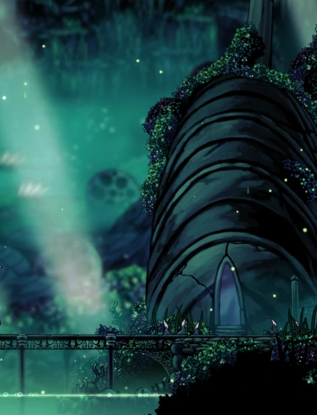
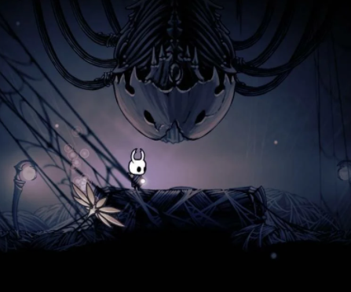
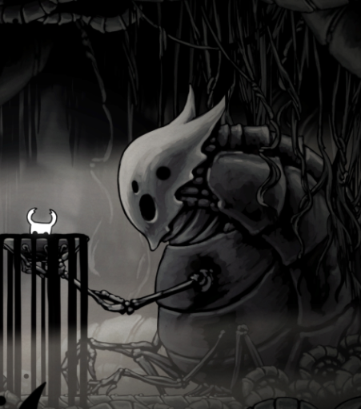
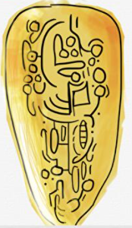
Environmental Details
Use of the unknown: player often moving into areas with little knowledge, in dark environments, frequently expecting to jump into sections without knowing
Ware of the city: the ruins of the cities tells the stories of the past.
Small Details: thing like text,diary entries and wall drawings
Notes:
The actual script:
The environment that the player travels through is completely jam packed with little details that progress the plot and slowly uncover the story to the player. Frequent recurring theme of skeletons and bug shells littering the ground gives the player the feeling that this world existed outside of their interactions with the game, and raises more questions about the world than it gives answers.
The game uses vast variety in architecture to differentiate between the forgotten tribes, uses overgrown nature to show the areas being abandoned or destroyed and the visual of grand untouched remains of bug shells is an extremely clever way to show how the areas have completely died of life.
On top of that the game scatters little texts for the player to uncover and a lot of players have dedicated a lot of time on uncovering the texts and information hidden within the tablets scattered around the game.
Notes:
frequent recurring theme of skeletons and bug shells littering the ground. Though they are usually in the background, the sheer size of these skeletons does a great deal of storytelling. Many of the bones are cracked and falling apart, some have moss grown over them, and others are seemingly untouched time.
Hollow Knight is a game that values the mystique of its world, leaving he player the freedom to find the answers on their own. The amount of detailing in the environment tells so much, and yet gives even more questions for the player.
The roads and walls of the city are crumbling away, worn down by time and persistent rainfall from the cavern ceiling above. Scattered across the city floors are also bodies of what might have been previous residents of the city.
Greenpath is an area in Hollow Knight that appears to be what once was a city, but has long since been overrun with invasive plants and forestry. There are plenty of city remains that are covered in creeping vines and clusters of foliage. An area that is next to this one, the Queen’s Gardens, has forestry very similar to what is seen in Greenpath. Thus, it is possible to deduce that the overgrowth taking over these city ruins is from the gardens nearby, ones that have been uncared for in ages due to the mysterious events that befell this world.

Slide 19
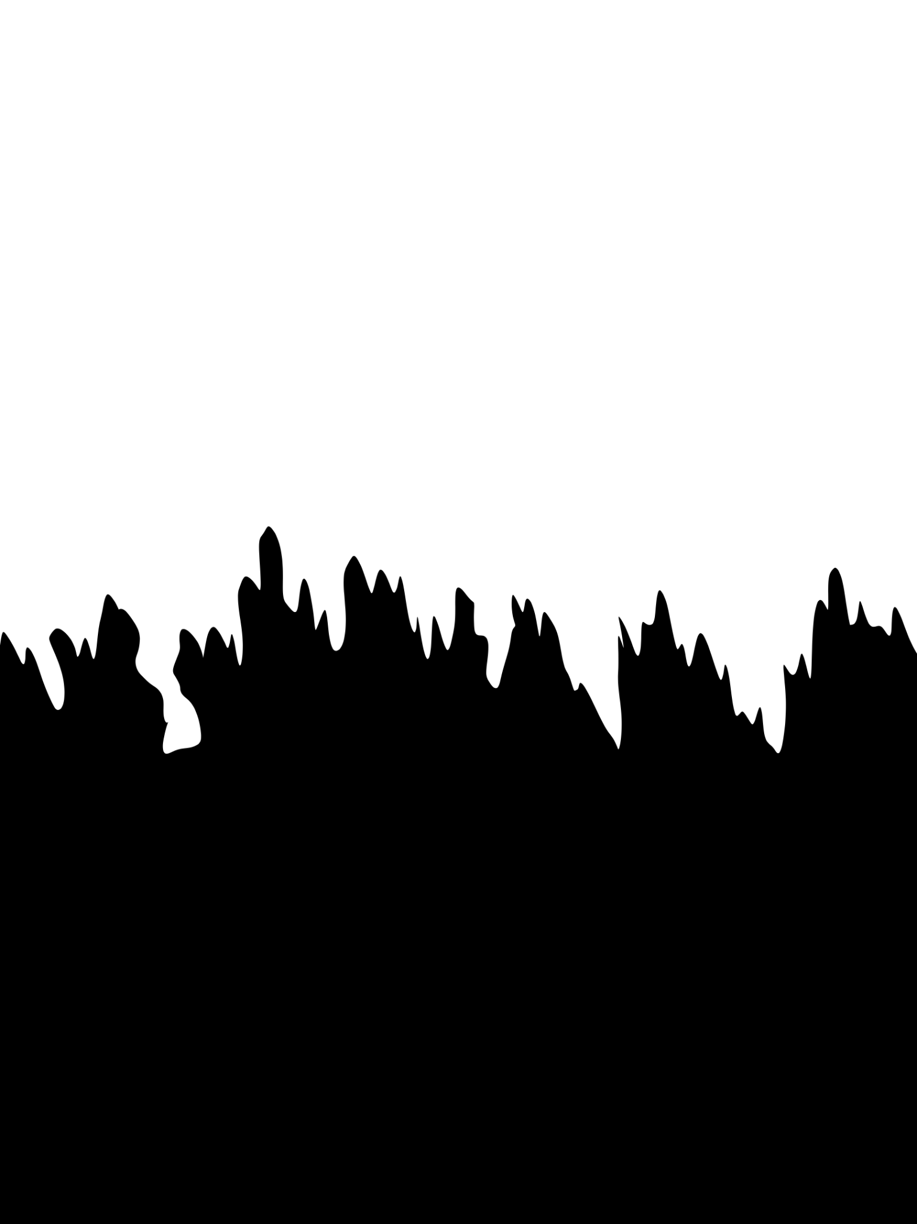
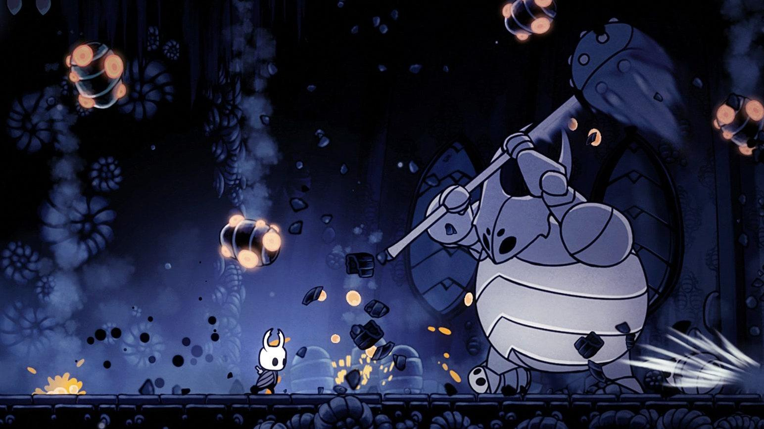
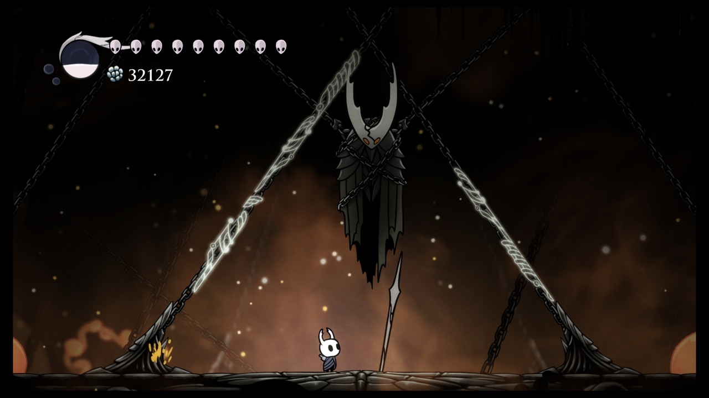
Player vs Environment
Use of scale: the player is
small in comparison to almost every aspect of the environment (enemies and backgrounds)
Secret areas: available to the player from environmental hints.
Responsive environment:
After the Knight kills one of the Dreamers or acquires the Monarch Wings, the Infection from the Black Egg spreads and intensifies
Notes:
The actual script:
The game uses a very clever use of scale. The player is very small in comparison to the enemies that he fights, as well as the colossal environments he traverses through which makes the environment a lot more threatening and overwhelming to the main character. Playing such a small creature in such a large and dangerous world creates empathy for the main character and allows the player to really immerse themselves in the Knight’s journey.
The environment uses a lot of environmental hints throughout the game to hide secret areas and plot points. For example: One of these secret rooms is tucked away, with the only hint to its location being a small pink crystal on a wall. This pink crystal, though easy to overlook, is very out of place in the environment as those crystals are usually common in a different area.
Additionally, the environment is responsive to the players actions. Apart from the openable areas the game reacts to the players moral game decisions too, for example: after the player kills one of the Dreamers, a boss in the game, the infection in the game spreads and intensifies affecting the surrounding map.
Notes:
Playing as a small creature in this expansive, dangerous world really helps the player to develop an empathy for them, the events that happen throughout the story will affect the player differently than if they hadn’t developed this empathy.
In one portion of the game, the main character learns an ability that teaches them how to dash over long distances. There is a hall full of these pink crystals that act as hazards, but normally the player’s jump does not reach past this hall. However, when the player acquires this ability, they are able to dash over the hall to safety. Without having to prompt the player with words, the environmental clue left at the location where the player learned the ability hints at what they will need to do at this hall of crystals.
Secret rooms are also left to be discovered in the world of Hollow Knight. One of these secret rooms is tucked away, with the only hint to its location being a small pink crystal on a wall. This pink crystal, though easy to overlook, is very out of place in the environment,
After the Knight kills one of the Dreamers or acquires the Monarch Wings, the Infection from the Black Egg spreads and intensifies.

Slide 20
References
Fig 1: cysipy, 2020. How do i get this last grub?. [image] Available at: <https://www.reddit.com/r/HollowKnight/comments/ex9gj7/how_do_i_get_this_last_grub> [Accessed 12 March 2022].
Fig 2: False Knight. [image] Available at<https://hollowknight.fandom.com/wiki/False_Knight> [taken 12 March 2022].
Fig 3: Tuk. [image] Available at: <https://hollowknight.fandom.com/wiki/Tuk> [accessed 13 March 2022].
Fig 4: ManicInqusition, 2019. Hollow Knight Progression Map. [image] Available at: <https://www.reddit.com/r/HollowKnight/comments/c9o46h/hollow_knight_progression_map> [accessed 13 March 2022].
Fig 5: Shade Lord with Hornet? [image] available at: <https://cardinailed0.tumblr.com/post/183593112414/shade-lord-with-hornet> [Accessed 13 March 2022]
Fig 6: Radiance [image] available at: <https://hollowknight.fandom.com/wiki/Radiance> [Accessed 13 March 2022]
Fig 7: Hollow Knight [image] available at: < https://crakthesky.wordpress.com/2019/04/26/hollow-knight/ > [Accessed 13 March 2022]
Background used in Slides x-y: Clark, T. (2022) 2560X1600 Hollow Knight Wallpaper Background Image. View, Download, Comment, And Rate - Wallpaper Abys… | Background Images, Wallpaper Backgrounds, Theme Background [online], Pinterest, available: https://www.pinterest.ie/pin/141441244534189020/ [accessed 13 Mar 2022]
Fig 8: the Fountain[image]<https://www.reddit.com/r/HollowKnight/comments/t4zbxi/with_6262_of_votes_greenpath_is_eliminated_making/> [Accessed 13 March 2022]
Fig 9: Lore Tablet [image] available at <https://www.eurogamer.net/articles/2019-09-10-how-hollow-knights-community-crafted-gibberish-into-a-real-language> [Accessed 20 March 2022]

Slide 21
The End

